Slide 1
Deep learning Seminar
In Sierra BASE
RPN(loss),
BACKbone: resnet50,
Loss 수렴하게
fasterRCNN 내용추가
Augmentation, Ensemble, BiFPN codes, FocalLoss,
2021. 07. 22 정재형

Slide 2




Augmentation : Difference between Classification & Detection
1/10
Common augmentation method :
Mirroring,
Random Cropping
Rotation
Shearing
Local warping
Color shifting(Changing value of RGB)
Original
Mirroring
Vertically Mirroing
Commonly used
Cropped
+90。 Rotate
-60。 Rotate
With augmentation, accuracy can be higher
because Number of data is increased,
also can prevent overfitting through augmented data
Hard reason of augmentation in detection :
annotation, bounding_box
Input, BB
Mirrored Input, BB
Mirrored Input, Mirrored BB
For augmentation in object detection,
You have to change not only input images
But also annotations(include location of BB)

Slide 3

2/10
Multi-Scale Inference with augmentation
Original
Augment with various method
(Up⋅Down scaling, flip, rotate, etc.)
Scale*1.5
Ensemble
+90。 Rotate
Model Architecture
Flip Horizontally

Slide 4
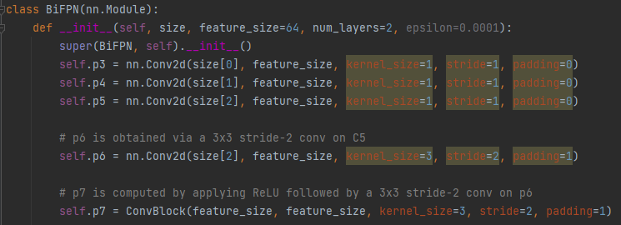
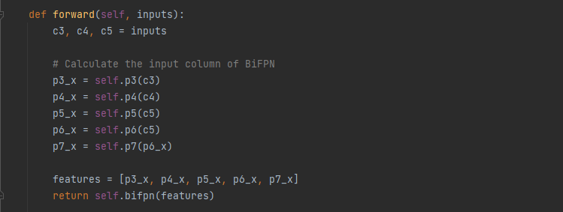

3/10
BiFPN Analyzation with codes
Bi-FPN
P7
P6
C5
P5
C4
P4
C3
P3
Input
Backbone : EfficientNet

Slide 5
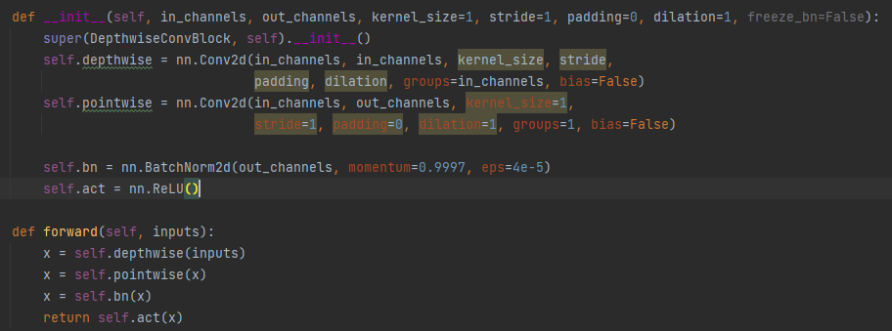
4/10
Depthwise Separable Convolution in BiFPN : Depthwise + Pointwise
Depthwise Separable
Convolution
Depthwise Separable Convolution : Depthwise + Pointwise Convoluion
Depthwise Convolution :
Extracts spatial feature at each channel.
There will be featuremap with number of groups.
And then it is added
Pointwise Convolution :
Calculate each channel with 1*1 convolution.
With this convolution, the input channel can be changed at output channel

Slide 6
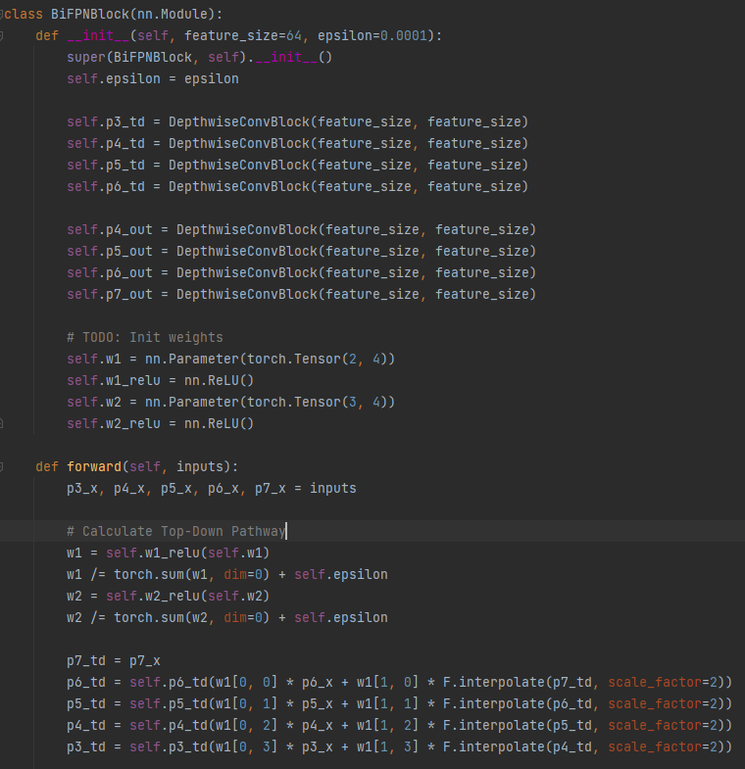
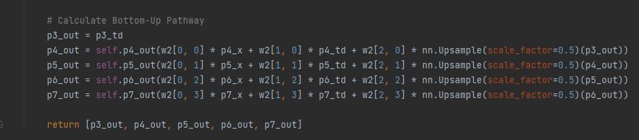
5/10
BiFPN Analyzation with codes
Depthwise Convblock
Pointwise Convblock
Bi-FPN
P7
P6
P5
P4
P3

Slide 7
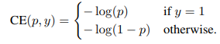
Focal Loss는 1stage detector에서 GT, BG간에 극심한 불균형이 있을때 사용하기 위해 고안됐습니다
.
6/10
Focal_Loss compared with CrossEntropy : Limitations of CE
Estimated probability for class
loss
otherwise
Ground-truth class
If class is GT, loss get lower if probability goes to (1)
If class is BG, loss get lower if probability goes to (0)
Limitations :
During training procedure in 1stage_detector, if there is extreme im-balance between foreground(GT) and background, accuracy can be low.
p
0
1
If y=1

Slide 8
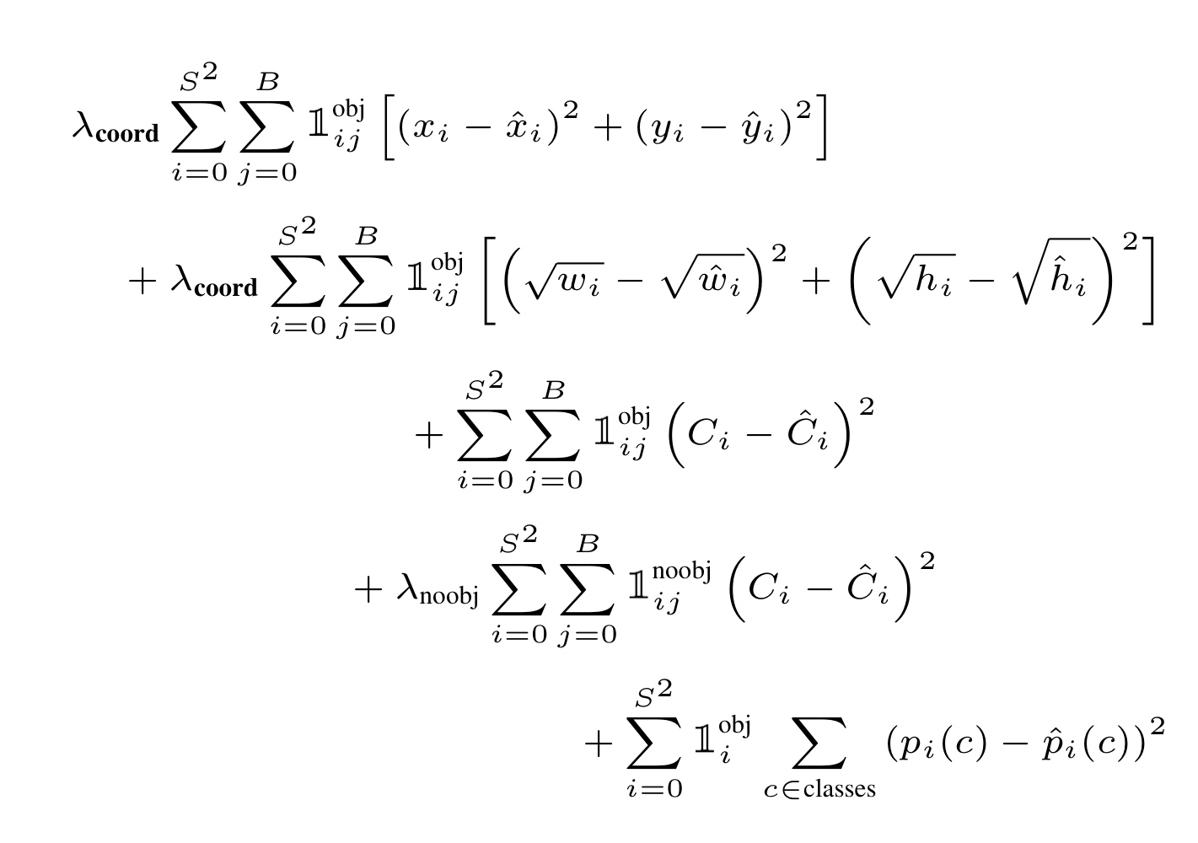













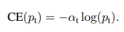
7/10
Trials for Class Im-balance
SSD : Hard negative mining
MINIBATCH
YOLO : confidence loss + class_pr loss with weight
Confidence Loss
10:1
Class Probability Loss
3 : 1
Pr(object)∗IOU(pred,truth)
Pool of
Negative
Samples
Pr(class)∗IOU(pred,truth)
Pool of
Positive
Samples
CrossEntropy : give weighting factor 𝛂

Slide 9
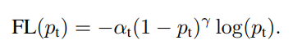
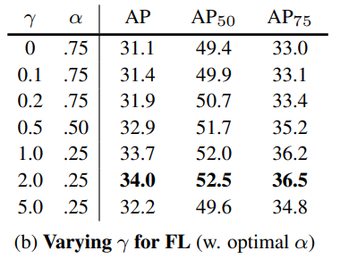
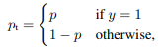
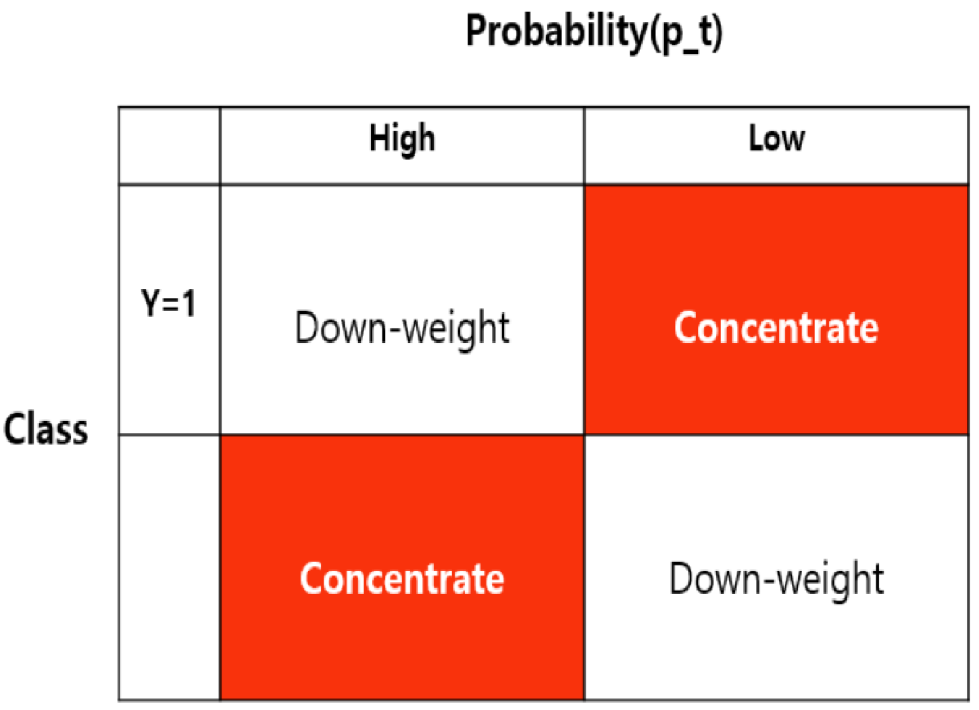
8/10
Focal Loss : More natural & effective way to im-variance
Find (𝛂 , 𝛄) with research using AP as an indicator.
When (𝛂 =0.25, 𝛄=2.0), result was best.
loss
For pt = 0.5,
loss=(0.023, 0.151, 0.3)
2
𝛂 = 1, 𝛄=1
p
0
t
1
Focal loss performance
(𝛄=0) =CE
Oth.
𝛂 = 0.25, 𝛄=2

Slide 10
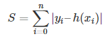
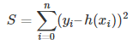
References
9/10
Focal_Loss paper:
https://arxiv.org/pdf/1708.02002.pdf
BiFPN Logic :
https://github.com/zylo117/Yet-Another-EfficientDetPytorch/blob/c533bc2de65135a6fe1d25ca437765c630943afb/efficientdet/model.py#L55
BiFPN logic(2) :
https://amaarora.github.io/2021/01/13/efficientdet-pytorch.html
BiFPN logic(3) :
https://github.com/tristandb/EfficientDet-PyTorch/blob/master/bifpn.py
Multi-Scale Training&Inference :
https://hoya012.github.io/blog/Tutorials-of-Object-Detection-Using-Deep-Learning-performance-two/

Slide 11
Work Schedule
10/10
 | 3주차(~7.19) | 3주차(~7.21) | 4주차(~7.27)
 | 1Stage Detector 발표Feedback - IoU 계산 코드 분석 - SSD에서 BB그려주는 코드분석 - Fully Connected, Convolution Network 차이 - BIFPN 코드분석 | Augmentation Loss(focal, CE비교(자세히) Ensemble (multi-scale inference) BIFPN 코드분석 | Inception+Resnet 짜서 Classification하기 (Auxilary layer빼고 Concat, Shortcut무조건넣기 비율줄이고 구조와 기능을 중점적으로) 인간 Dataset 다운로드 (종류상관없음 많ㅇ)

